Slide 1

Los Angeles city College
WELCOME!

Slide 2
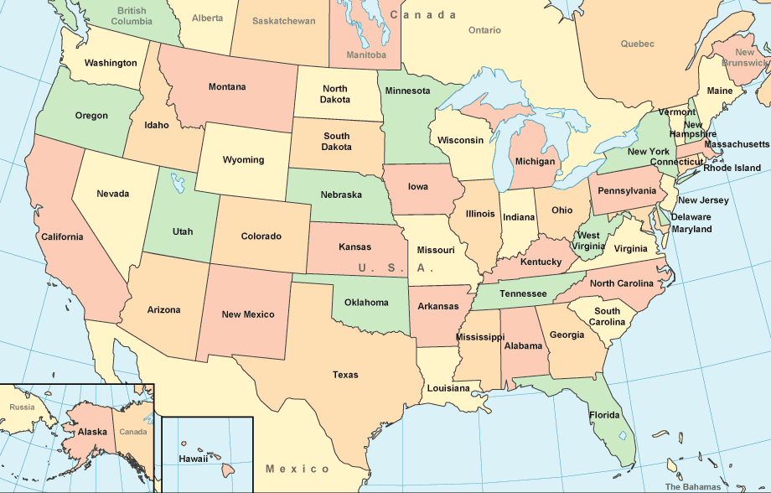

Welcome to the United States!

Slide 3

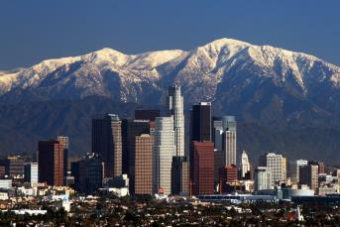

Los Angeles, CA – City of Angels
Second largest city in the United States
City is divided in over 80 neighborhoods
Over 502.7 square miles
Diverse population over 4,000,000 people

Slide 4
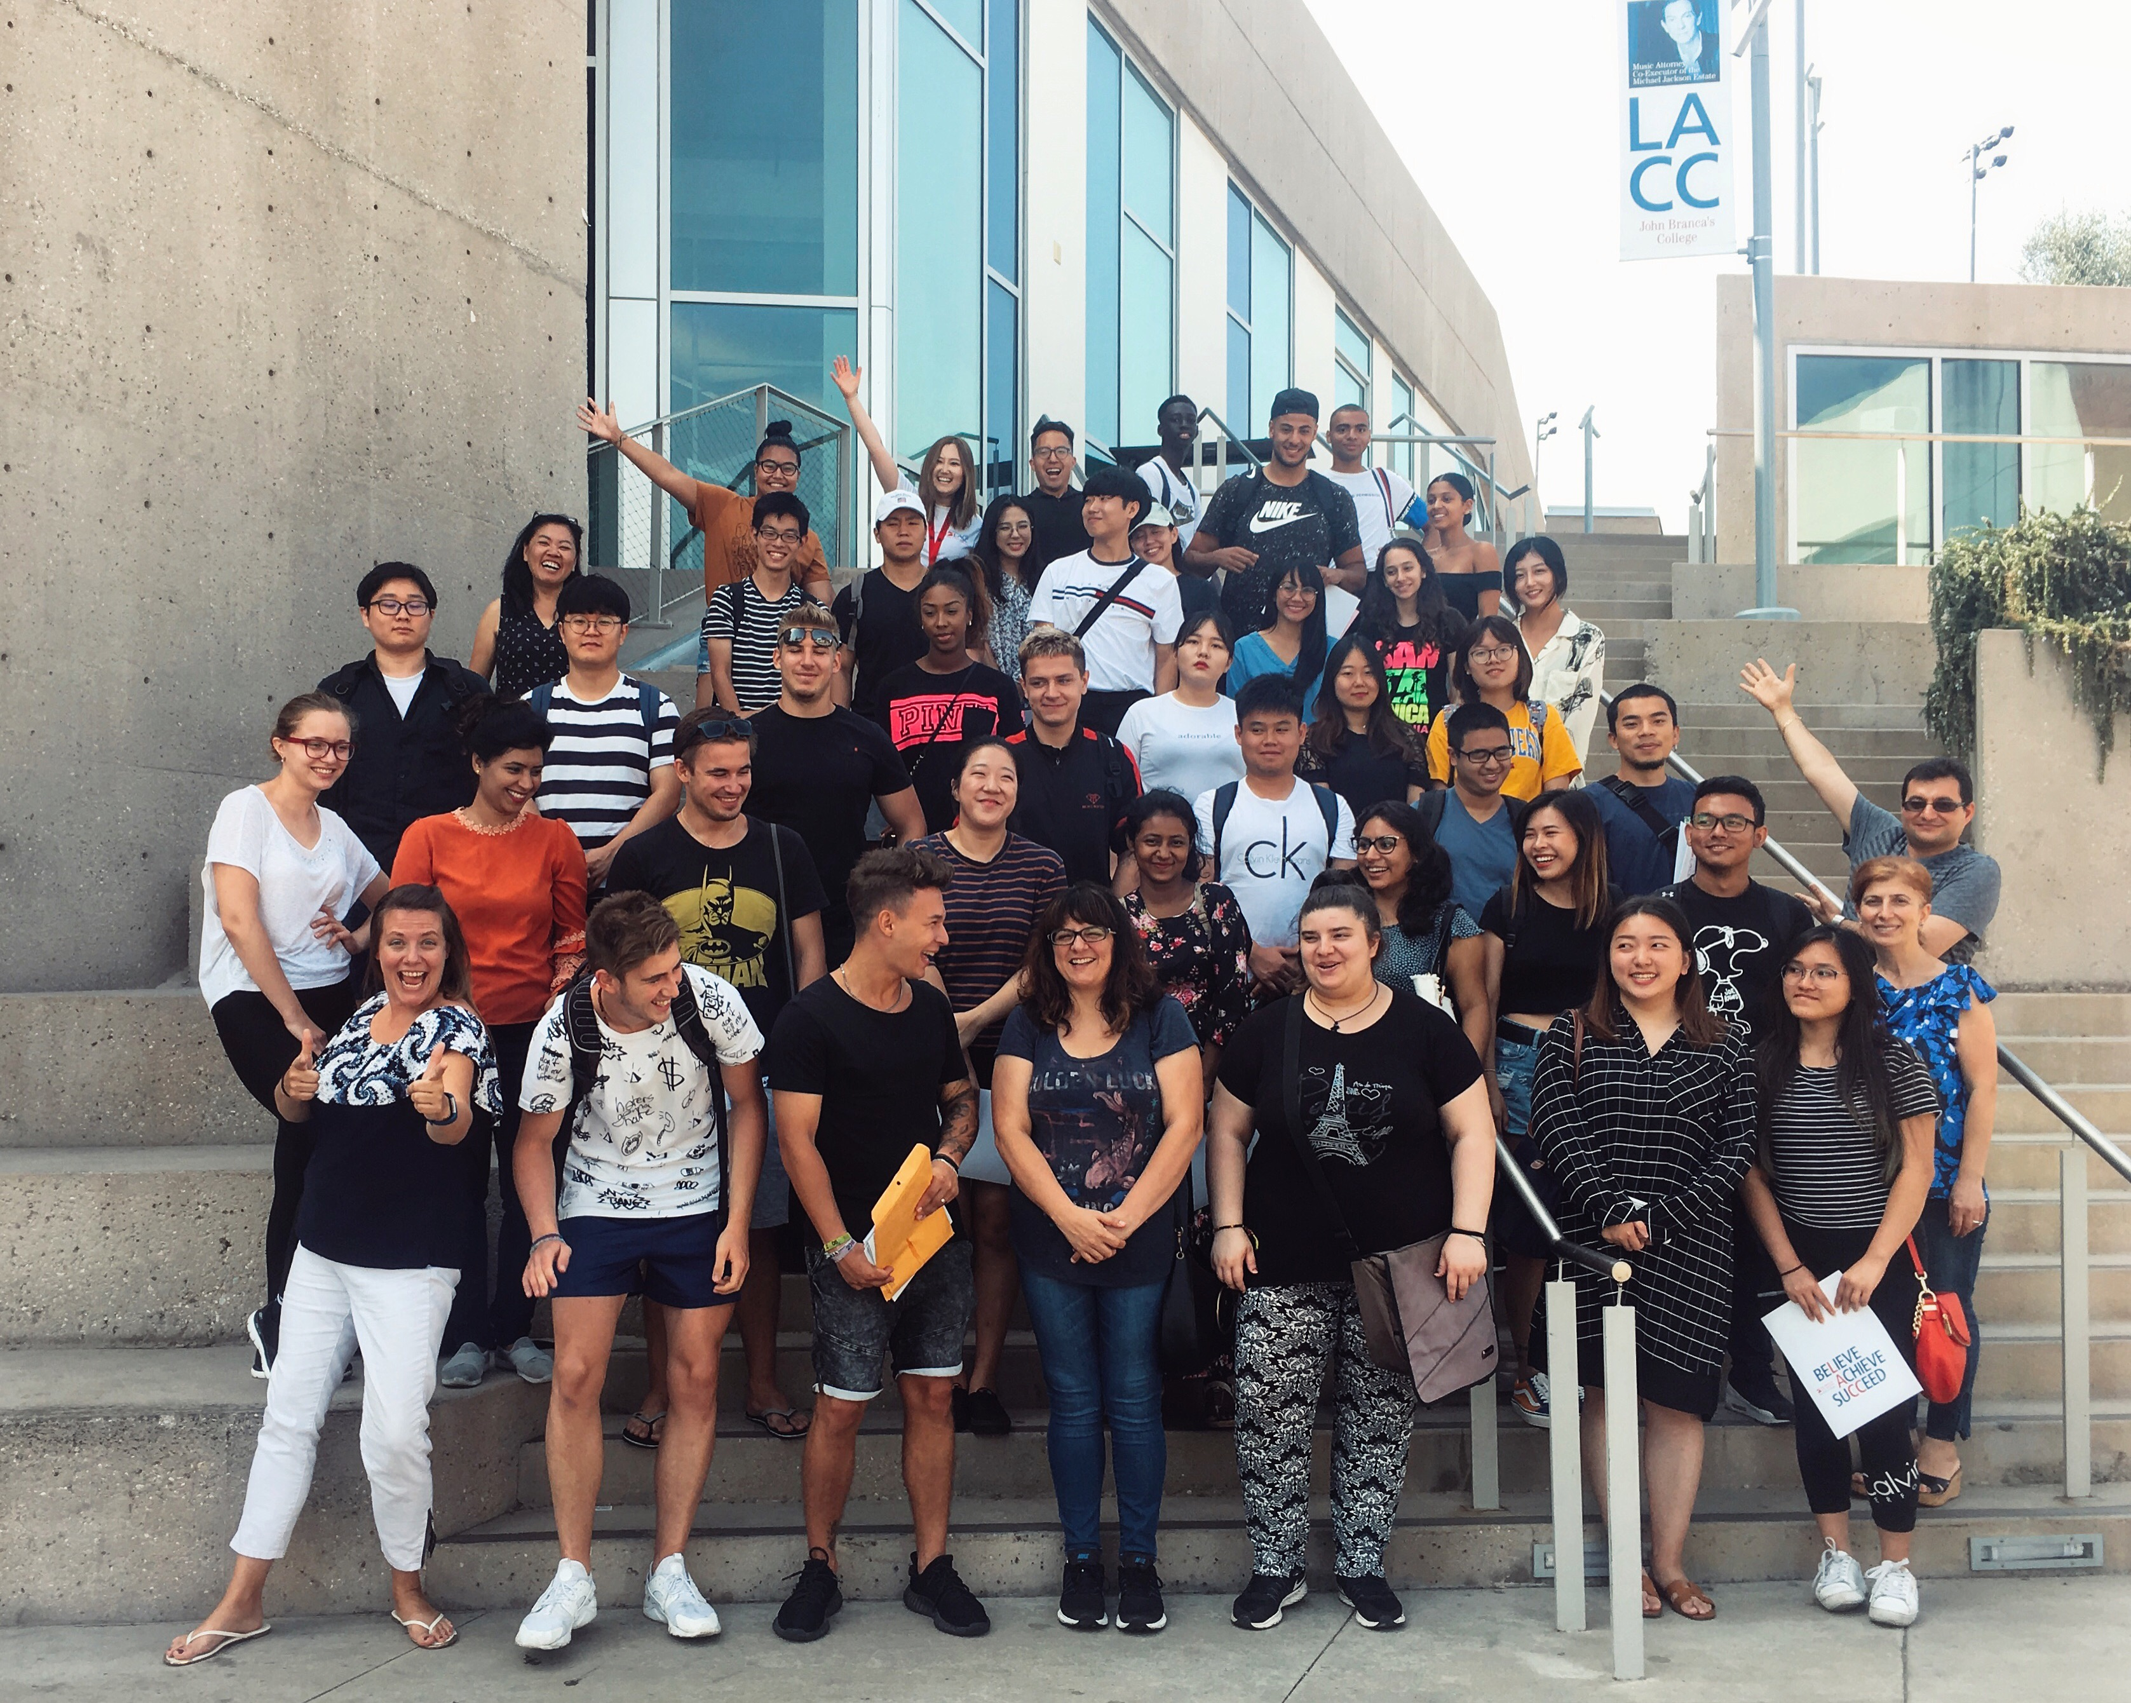
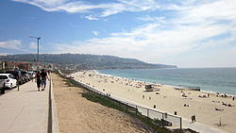
LACC Language Academy
Located in Hollywood, CA at Los Angeles City College
Hollywood is a city near downtown L.A.
1.5 miles of Pacific Ocean Beaches
Population of nearly 100,000 people
Known for low crime rate and consistently rated one of the safest cities in Los Angeles County

Slide 5
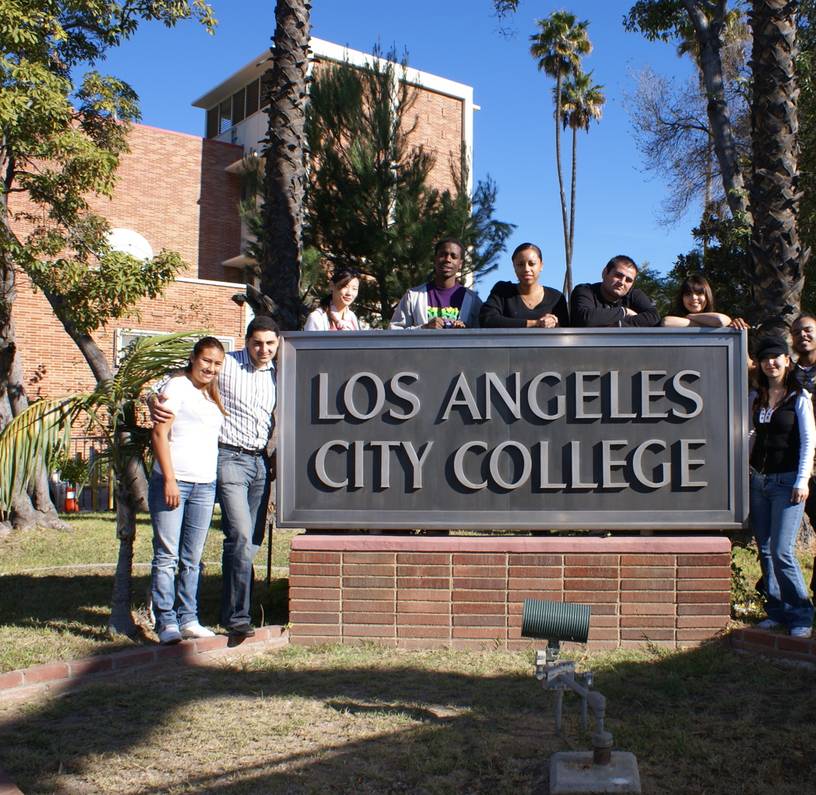
Los Angeles City College
About LACC
Students who successfully complete our Language Academy or have a passing TOEFL score can transfer LACC
Los Angeles City College
  23,000 students total
  260 international students
Over 60 countries studying
Athletics program – Sports!
Arts, Theatre, Film, & Music
Spring and Fall Semesters: 15 weeks
Summer Session: 8 weeks

Slide 6
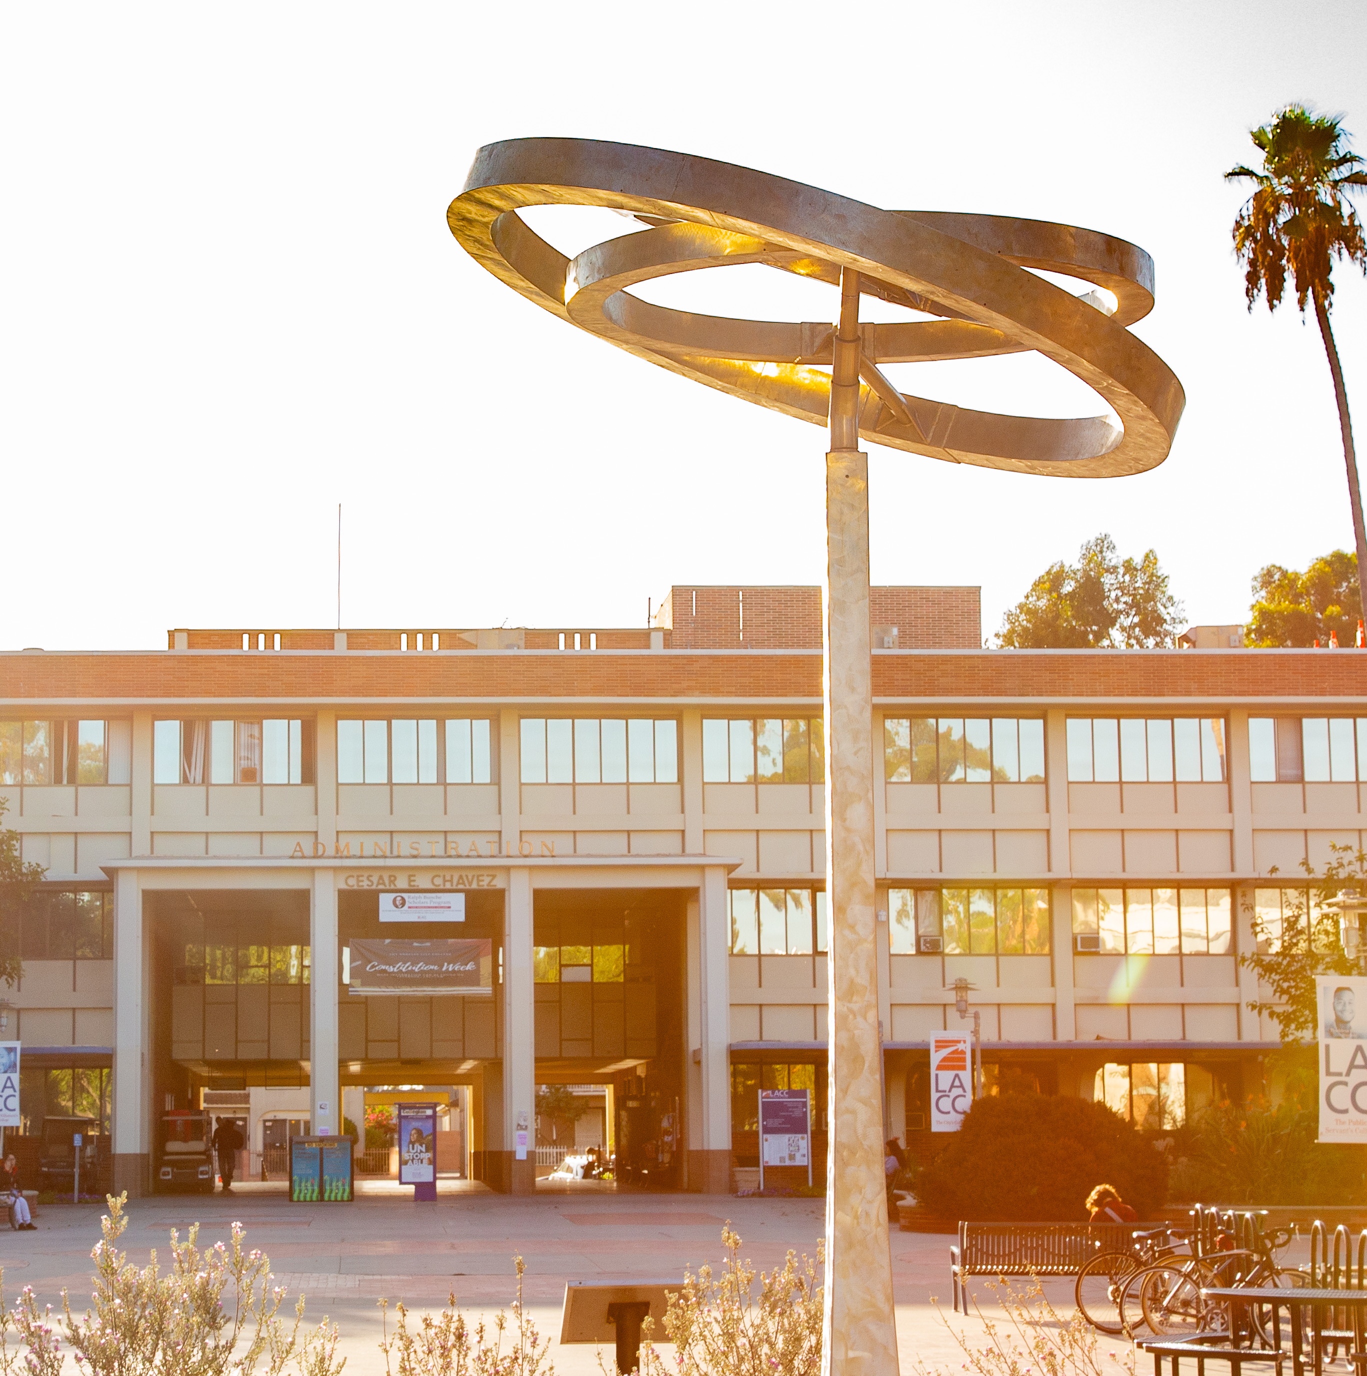
LACC Language Academy (LA@LACC)
Agenda
Expectations
Tuition & Fees
Health & Safety
Getting Around
  Bicycle
  Public Transit
  Car
Culture Shock
Cell Phones
Banking
Meeting People

Slide 7
Class Overview
Level 1 - Basic
Module 1A (Lower Beginner)
Module 1B (Upper Beginner)
Level 2 - Intermediate
Module 2A (Lower Intermediate
Module 2B (Upper Intermediate)
Level 3 – Advanced
Module 3A (Lower Advanced)
Module 3B (Upper Advanced)
Subjects
American Culture & Conversation
Reading
Writing
Grammar
TOEFL
Monday & Wednesday
Writing & Reading
12pm - 4pm
Ms. Michelle O'Hair
Tuesday & Thursday
Grammar & Culture
12pm – 4pm
Ms. Alla Bohkman
Friday
Conversation
10:30 – 1:30pm
Ms. Haira Chang
Location: Da Vinci 301

Slide 8
Class Overview
Classes meet Monday-Thursday from 12pm to 4pm & Friday classes – 10:30am – 1:30pm
YOU MUST ATTEND CLASS
  This is a restriction of your F-1 visa
  Attendance is part of the grading
Course materials are all online
Syllabus will be given by instructors – a plan for the class
Each time you come to LACC, you must complete the Covid-19 Survey and enter the campus as a visitor.

Slide 9
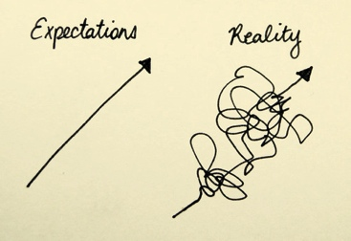
Language Expectations
Attend class
Be on time
No cell phones in class
Adhere to immigration rules
Participate
Communicate
Graduate!

Slide 10
Tuition & Fees
Payment Options
How to Pay
Tuition is due by the first week of class
Ways to Pay: Flywire. Check, Money Order, or Cash.
Where to Pay: Online, or at the International Student Office, Administration Building, Room 109.
Classroom materials can be bought at bookstore SEPARATELY
Online
Step 1: Go to our website.
Step 2: Select Make a Payment.
Step 3: Select Flywire Payment
In Person
Step 1: Go to the International Program Office, Cesar Chavez Building room 109
Step 2: Ask for Mr. George Agoian or Ms. Elonda Austin to make payment.

Slide 11
Health & Safety
Insurance is strongly recommended – you are not covered in the United States, and you MUST have insurance to see a doctor or you will spend THOUSANDS of dollars.
Medical Insurance
  https://www.lacitycollege.edu/Resources/International-Students/Language-Academy/Medical-Insurance
Urgent Care
  Going to the hospital is VERY expensive – always go to Urgent Care FIRST
Local drugstores will carry non-prescription medicine for:
  Colds, headaches, stomachaches, allergies, cuts, etc.
  Stores will have a pharmacy to help you find medicine you need
  Stores include: CVS, Walgreens, RiteAid, etc.

Slide 12
COVID-19 PROTOCALS
Complete
Complete the COVID-19 Survey
You are required to complete this survey every time you come to LACC.
A link to the Covid-19 survey is located on the International Student Program website.
Check
Check Point Entry
To enter LACC you will enter through a check point marked as Visitor. Only go through the Visitor entrance.
You will be asked to show proof that the survey was completed.
Mask
Mask Mandate
LA County requires that masks be worn indoors.
LACC requires that masks be worn in all indoor spaces.

Slide 13

Safety
Be aware of your surroundings
Keep phones, wallets and purses near you
Always carry your ID card
Emergency – call the police 9-1-1
Do not do things that you would not do in your own country – be safe
Do not walk late at night by yourself

Slide 14
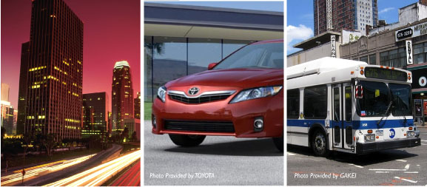
Getting Around

Slide 15
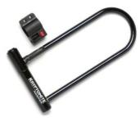

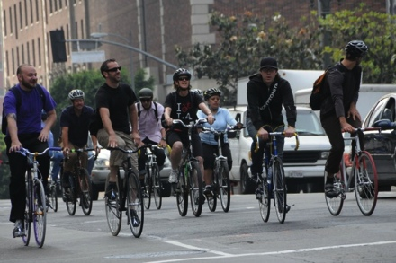
Bicycling
Locks, locks and locks – BUY A “U LOCK”
Bike Lights – it’s the law
Hand Signals
Helmets – not the law, but important

Slide 16
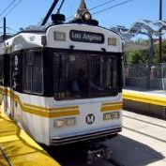
Public Transportation
Metro
  A Metro bus or rail line is always around the corner at LA City College, making it easy to get from campus without a car to Los Feliz, Hollywood, Downtown Korea town and more.
  Blue Line: Service to, Los Angeles and Downtown Long Beach. Possible destinations include: Staples Center and LA Convention Center Watts Towers, Queen Mary and the Aquarium of the Pacific
  Expo Line: Service to popular destinations such as: USC, Exposition Park (including the California Science Center and Natural History Museum), Crenshaw District, Culver City, Santa Monica Pier and Third Street Promenade
Taxi
  Book online at: www.yellocab.com
  Book via text – (310) 574- 2228
  Call (424) 222-2222
Uber & Lyft
  Public taxi service – every day people in personal cars
  Available via mobile app – must have credit card/debit card

Slide 17
Cars – Driving on an F1 Visa
You Need a Drivers License to drive in the U.S.
Scheduling an appointment at the DMV
Pass test in English
What you will need:
Letter of enrollment from LACC
Passport with Visa stamp inside
I-20
Something with your U.S. address listed – utility bill, bank statement, phone bill, etc.
If you plan to drive, you MUST purchase car insurance – it is ILLEGAL to drive without car insurance in the U.S.
If you have a license, you can rent a car or zipcar

Slide 18
Drugs, Alcohol and Smoking
Legal Drugs in the United States
Alcohol is legal for adults over 21 years old
Nicotine is legal for adults over 21 years old
Marijuana for MEDICAL purposes ONLY – need medical proof
Illegal Drugs in the United States
Cocaine, crack
Heroin, opiates
Ecstasy/MDMA
Mushrooms
Amphetamines
Ketamine

Slide 19
Cannabis (Marijuana)
Cannabis is legal in California
Cannabis is illegal in under Federal Law
Do not travel outside of the California with cannabis
Do not buy Cannabis on the street - you need a medicinal prescription card to buy marijuana in a store

Slide 20


Drinking
Must be 21 to drink – you can be arrested if you are caught drinking under 21 years old
ID required to get into bars and order drinks at restaurants
It is ILLEGAL to give alcohol to anyone under 21 years

Slide 21

No . . .Smoking Cigarettes/Vaping
Smoking on campus is NOT ALLOWED
Smoking in bars and restaurants is NOT ALLOWED
Smoking inside buildings is NOT ALLOWED
If you see a sign to not smoke, DO NOT SMOKE

Slide 22

American Culture
Equality
Hard work
Directness and assertiveness
Americans Value:
Independence
Personal space & privacy
Being on time

Slide 23

Culture Shock - Symptoms
Sadness
Loneliness
Frustration
Anxiety
Trouble concentrating
Feeling left out
Feeling misunderstood
Too much sleep
Too little sleep

Slide 24


Phase 1 - The Honeymoon
In love with everything you see and do
Life is wonderful
You feel GREAT
You never want to leave
Meeting new people is fun

Slide 25

Phase 2 – What Am I Doing Here?
Feeling as if you made a mistake . . . You are homesick
Little issues become BIG issues
Anger and frustration
Feeling ignored
Everything is hard
  Language is hard
  Shopping is difficult
  You cannot sound smart, funny or intelligent
  Transportation
  Measurement is different
  Money is different – coins!! No number on the coins

Slide 26


Americans can be . . .
  Distant . . . Too formal
  Inflexible
  Loud . . .Irritating
  But we love . . .
  A good restaurant (good food)
  Our families . . . Our friends . . .Our pets
  To laugh
  A good movie . . . A good concert

Slide 27

Phase 3 – Things Get Better
Let’s mend a broken heart . . .
You begin to feel at home
You have your humor back
You enjoy yourself
You make new goals
You make new friends
Start going out to see the sights
Things begin to make sense

Slide 28
Getting Adjusted
Be PATIENT – it takes time – 3-4 months
Remember your personal goals – why did you come here
See the adventure in being here
Use your sense of humor
Deal with stress as it comes up – do not let it build
  Work out
  Talk to someone – come to the office – we are here to help
Ask for help if you need it
Talk to friends and family at home
Volunteer
Meditate

Slide 29

Cell Phones
Monthly Plans
No Contracts
Carriers & Providers
Refer to cell phone guide
(set-up voice mail)

Slide 30

Banking
Savings vs checking
Different banks – Chase, Wells Fargo, CitiBank, etc.
Different accounts have different requirements
No Social Security numbers required

Slide 31
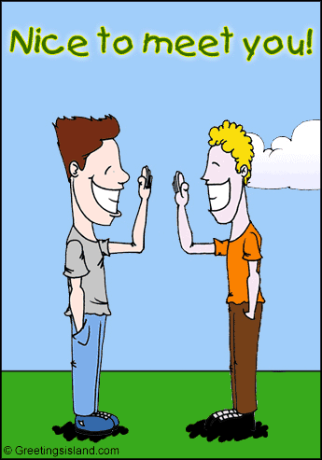
Meeting People!
Meetup.com
Student Clubs at LACC
LACC Language Academy!
Recreation classes
Study groups

