Slide 1
F VISA RULES & REGULATIONS

Slide 2
IMPORTANT TERMS
LA@LACC: Language Academy @ LACC
ISP: International Student Program
  PDSO: Primary Designated School Official
  DSO: Designated School Official
  SEVIS: Student Exchange Visitor Information System
  USCIS: US Citizenship and Immigration Services

Slide 3
What is an F-1 Status?
F visas are student visas that allows foreigners to study academic studies and/or language training programs in US
F-1 visas are only issued at U.S. embassies and consulates outside the United States
F-1 students must show that they are able to financially support themselves during their stay in the U.S. - employment opportunities are limited
F-2 visas are given to dependents of an F-1 student

Slide 4
How Long Can you Stay?
F-1 status covers the period when you are a full-time registered student making normal progress toward your degree, plus a 60-days "grace period" to prepare to depart the U.S. or change to another status.
Your length of authorized stay is not related to your F-1 visa expiration date. The F-1 visa can expire before your status expires, you are okay in the USA.

Slide 5

Have you checked in yet?
New F-1 students are REQUIRED to check in with Registration within 10 days of the start of the semester
Bring your documents to the International Student Office (Admin 109)
    I-20
    Passport
    U.S. Address

Slide 6
Documents
I-20
Passport
Visa
I-94

Slide 7
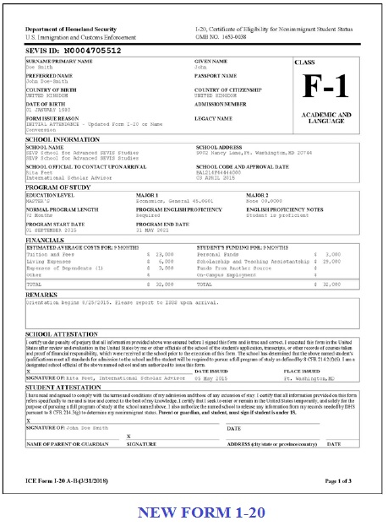
Form I-20
(F-1 students)
Biographical data
Program of study
Funding
Barcode
SEVIS ID

Slide 8
Your I-20…must be valid at all times!
We can extend your I-20 BEFORE it expires.
We cannot extend your I-20 AFTER it expires.
If your I-20 ends, your F-1 student status will terminate.

Slide 9
You are Required to Update your I-20 if…
  You need to extend your program
  You want to change schools
  You change your funding
  Your name changes

Slide 10
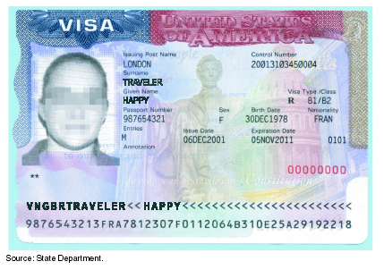
Visa Information

Slide 11
Visa Information
After you received your Form I-20, you applied for an F-1 visa at a US consulate.
Your F-1 visa has an expiration date. If the VISA expires while you are in the US, it is not a problem.
Travel outside the US requires a valid visa to reenter the US.

Slide 12
I-94 Card Updates
Your I-94 information is available to you though www.cbp.gov/I94.

Slide 13
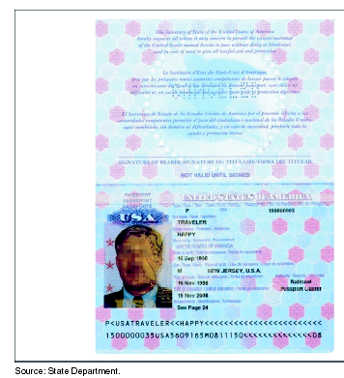
Passport

Slide 14
Maintain a Valid Passport
Your passport must be valid at least 6 months into the future
Passport renewal procedures vary, depending on country – typically, you may renew your passport 6 months prior to the expiration date
Contact your country’s embassy in the US to determine the procedure for obtaining a new passport

Slide 15
SEVIS
Student & Exchange Visitor Information System
SEVIS reports the following information to
USCIS (United States Citizenship and Immigration Services)
and ICE (Immigration and Customs Enforcement):
Personal Address Information
Financial Information— Education funding
Academic Program Information—full time/part time
enrollment, major changes, disciplinary actions, extension of
program
Employment Information: optional/curricular practical training,
off campus employment authorization
Termination or Completion of study
Dependent Information

Slide 16
Are you a new transfer student?
A SEVIS transfer (transfer of your SEVIS record) is different from an academic transfer (transfer of past academic credit and current program)
If you attended another institution in the U.S. before LA@LACC and you do not have an LACC I-20, you must transfer your SEVIS record to LACC.
Once you transfer to another school, you will receive a new I-20

Slide 17
CAUTION!
Employment in the US
You may not work while attending LACC

Slide 18
Social Security Numbers
SSNs are issued for tax purposes only. You cannot receive an SSN for identification purposes.
Dependents cannot receive an SSN.
You must have a Social Security Number (SSN) to work in the US – ECLA Students may not work

Slide 19
How to Maintain F1 Status
You are required to have 20 hours of Language Instruction
Attend class each week.
Do not be absent. If you need to miss class, speak with your instructor.
Attend class each week.

Slide 20
Termination and Reinstatement
A violation of status will result in a termination of your F-1 status
    This means that if you break the rules, your student status will be ended and you will need to either:
    1) Go back to your home country and reapply
    2) Apply for reinstatement
You must apply directly to USCIS requesting reinstatement back into F-1 status – this is expensive and time consuming

Slide 21
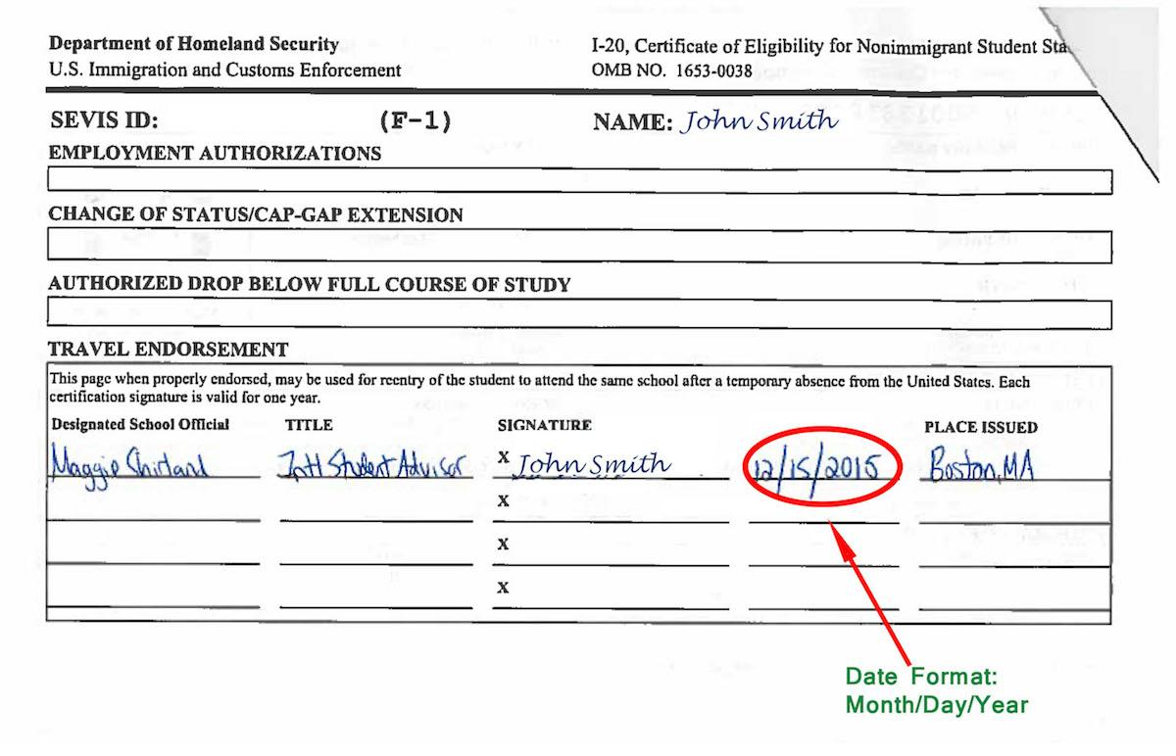
Travel Information
Travel IN the U.S.?
  No travel signature required
Travel OUTSIDE the U.S.?
  You MUST have your I-20
  be signed for travel by a DSO
Drop off documents at internationa office one to two weeks prior to international travel
Visa expired? You must apply for and receive a new visa before re-entering the United States
Carry copies of all your immigration documents if you travel to US border areas or large cities
Travel Signature

Slide 22
Change of Address Procedure
International students must update their address with-in ten days of moving.
Please contact la@lacitycollege.edu to update your Personal Data.
  This is a requirement of your visa status

Slide 23

COMMUNICATION IS KEY!
LACC communicates regularly with students by email
Bookmark and check the following websites regularly
Your Instructor
LACC STAFF

Slide 24
Office Hours
Monday through Thursday:
9:00 am- 4:00 pm
Fridays:
9:00 am – 3:00 pm

Slide 25
ECLA General
Contact Information
Cesar Chavez, Admin Services: 1st floor
855 N. Vermont Avenue, Los Angeles, CA 90029
LACC Phone:
Main Line (323) 953-4000 ext. 2470
George Agoian: ext.
Zoom Room: www.lacitycollege.edu/Resources/International-Students/Department-Home
George Email: gaoian@lacitycollege.edu
Main Email: la@lacitycollege.edu
Website: www.lacitycollege.edu/Resources/International-Students/Language-Academy

